Slide 1
Flows in Networks
Amir Hossein Kargaran

Slide 2

7.1 Transportation Networks

Slide 3



Flow

Slide 4
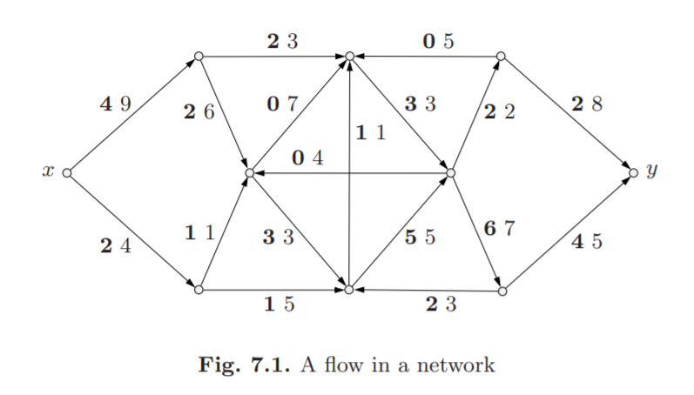

Slide 5
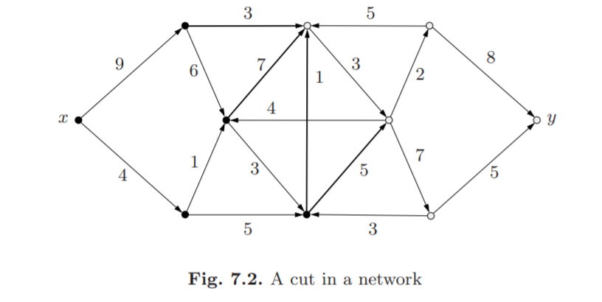
Cut

Slide 6



Slide 7

Maximum Flow- Minimum Cut

Slide 8



Slide 9



Slide 10



Slide 11
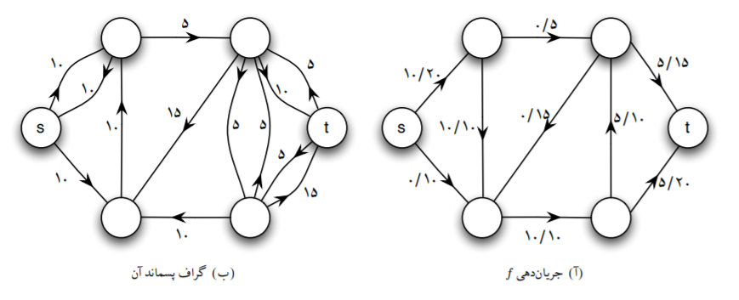

Slide 12
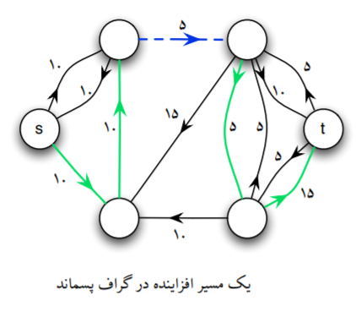

Slide 13
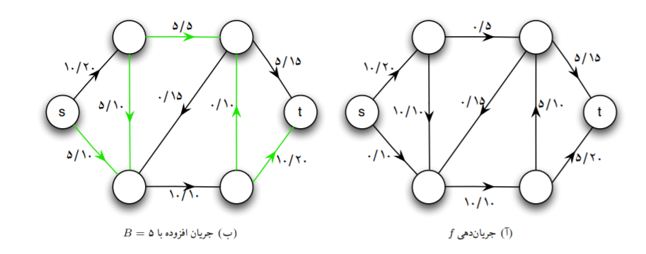

Slide 14
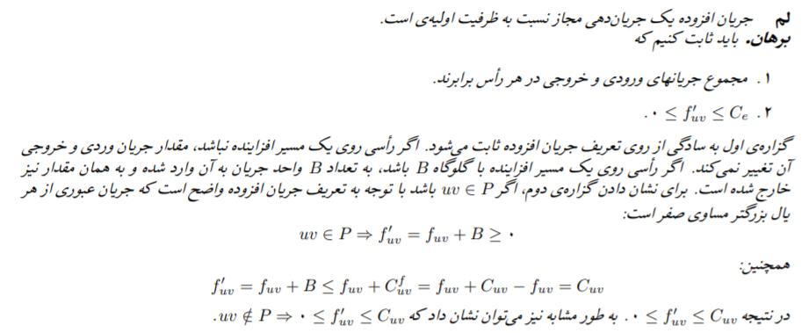

Slide 15


Slide 16


Slide 17
Refrences
Bondy and Morty Textbook
Analysis Algorithms course (SUT) Lectures

